Slide 1
Pain pills
Sales volume by state over time

Slide 2
Dataset details
Size: 12GB subset from 74GB
Source: https://www.kaggle.com/paultimothymooney/pain-pills-in-the-usa
Github: https://github.com/aleksUIX/CIS5200-team5

Slide 3
Analysis: sales breakdown by state / year
Overdose death rates have quadrupled in the US since 1999, and 40% of all deaths involve prescription opioids*, which are primarily used for pain relief.
Although the legitimate supply of opioids may have decreased, overall consumption will remain unchanged if users decide to source them from illicit markets.
Source: https://www.bmj.com/company/newsroom/us-painkiller-restriction-linked-to-significant-increase-in-illicit-online-drug-trading/

Slide 4
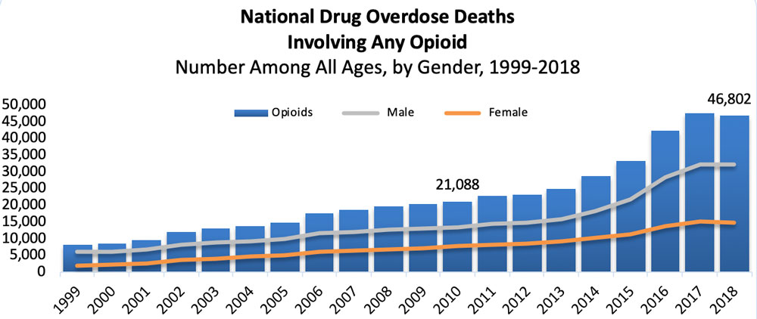
Goal: examine growth in prescription sales
Source: https://www.drugabuse.gov/drug-topics/trends-statistics/overdose-death-rates

Slide 5
Process
Filter out unnecessary columns from 40+ columns down to 4 in an intermedaite table drugs_year
Create a table grouped by year and reporter state
Download data as CSV and open in excel
Format time column, save as xlsx
Insert 3D map
Location: state, Height: quantity(sum/average), Category: drug name, Time: full date

Slide 6
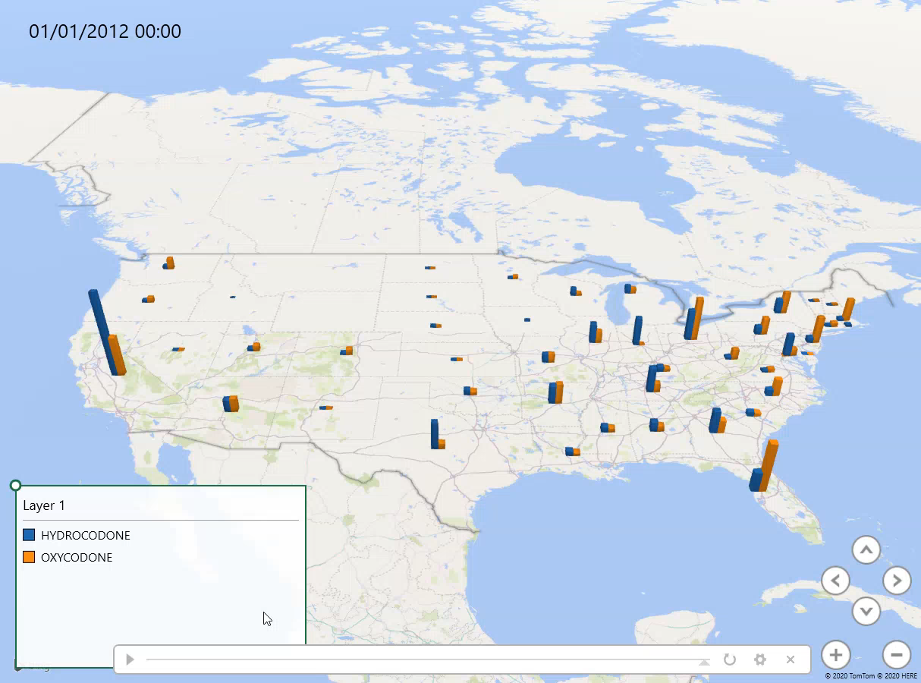
USA Trend over time – quantity (sum)

Slide 7
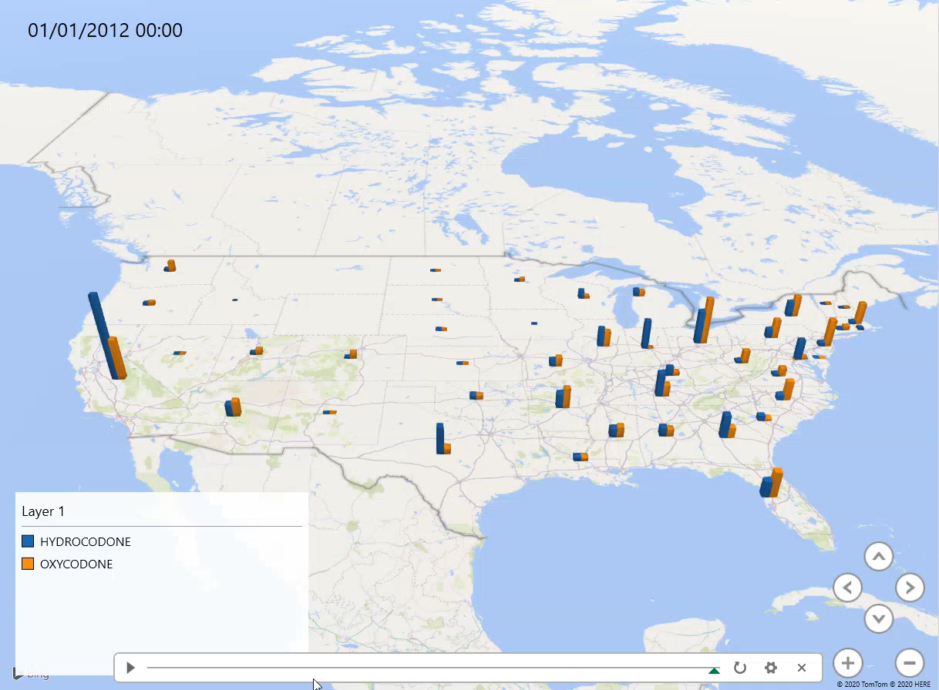
USA Trend over time – quantity (average)

